Slide 1

Machine Learning en Salud: predicción de riesgo cardiovascular a 10 años (R-Studio y Rapid Miner)
https://github.com/Juanjobeunza/Aprendizaje-Automatico-FRAMINGHAM

Slide 2
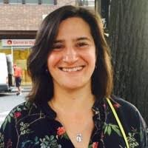

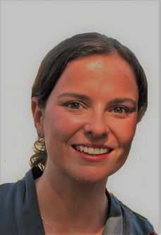

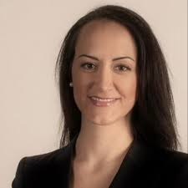
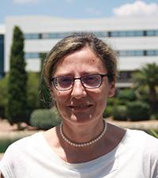


Machine Learning Salud-UEM

Slide 3
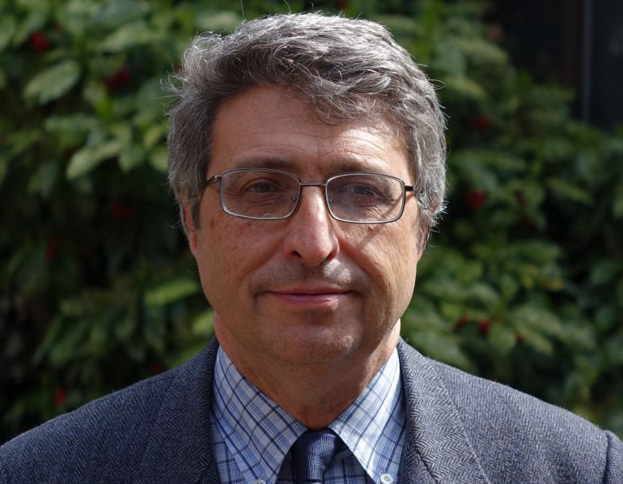
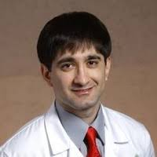

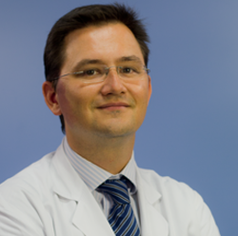




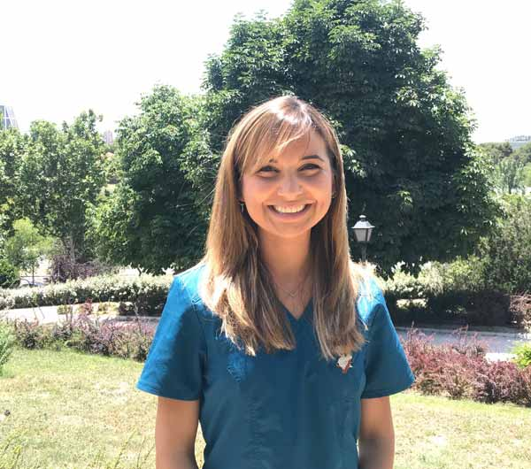

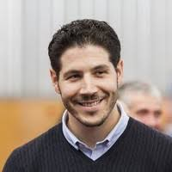
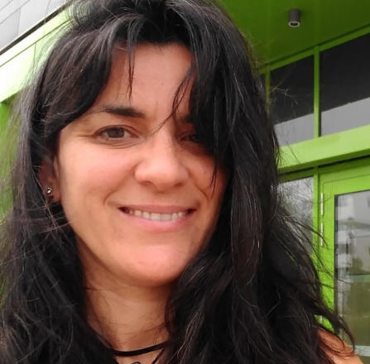
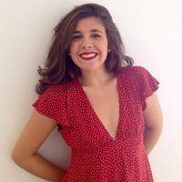

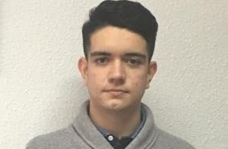


Machine Learning Salud-UEM

Slide 4

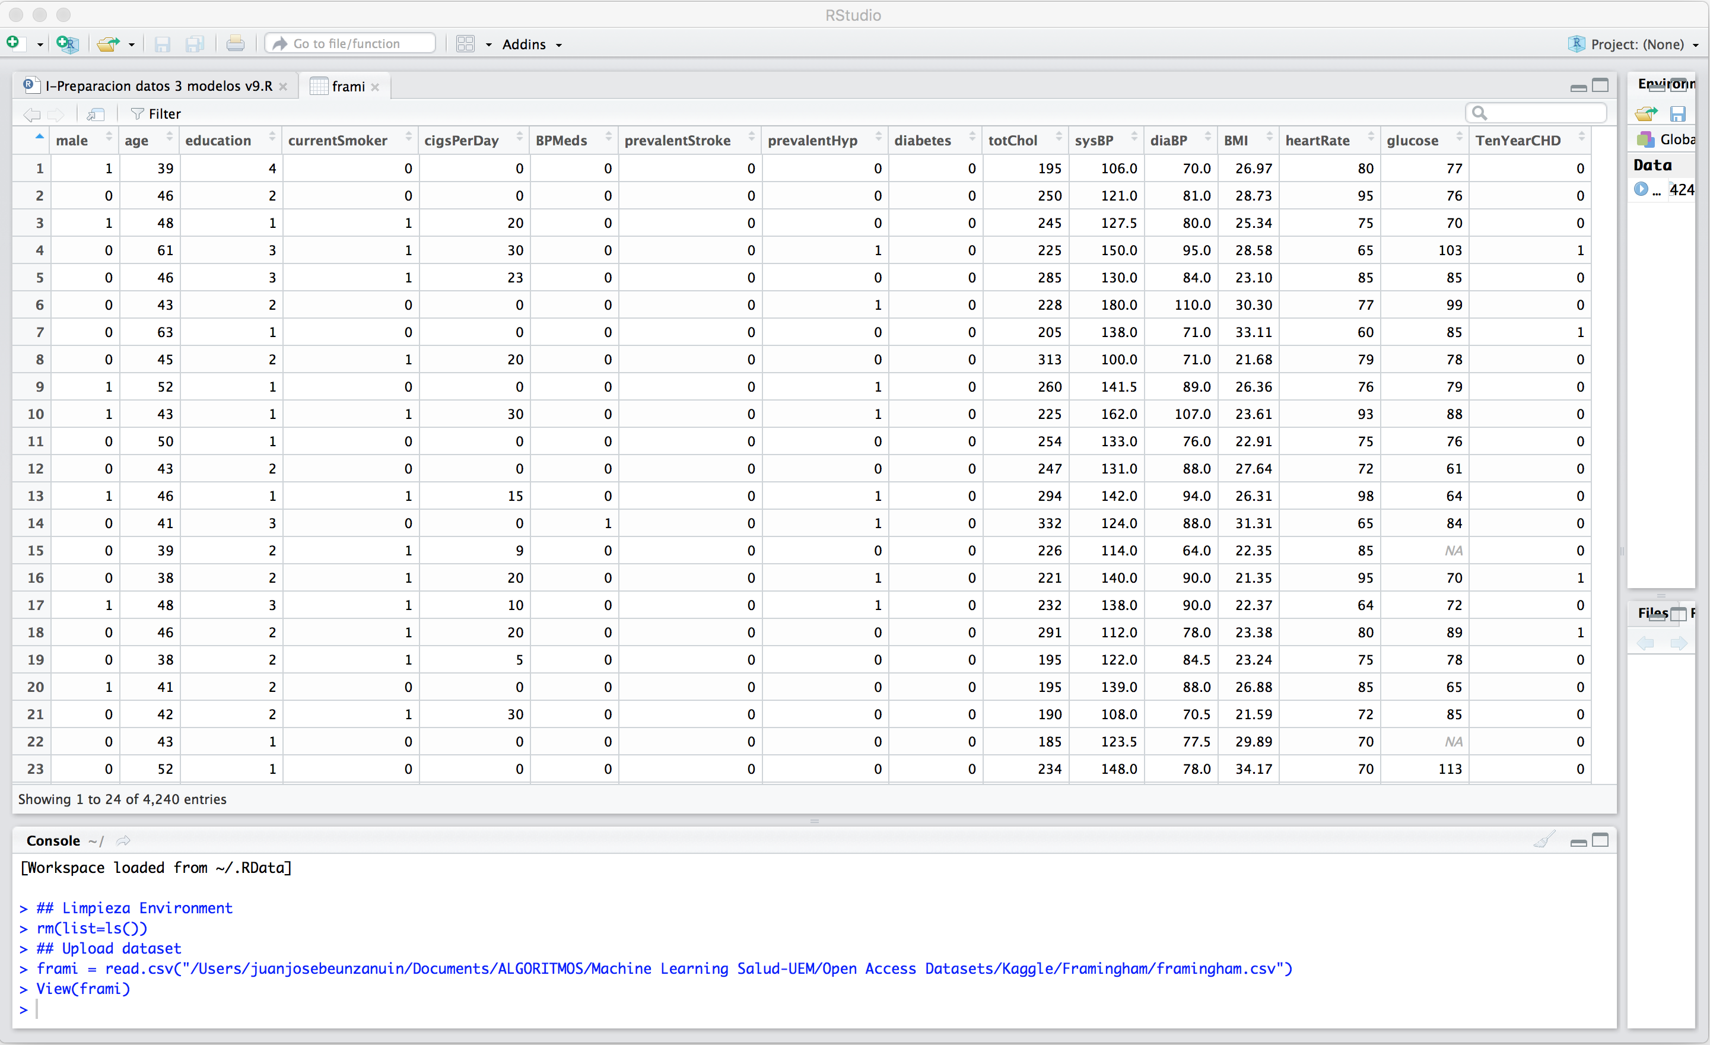





Slide 5
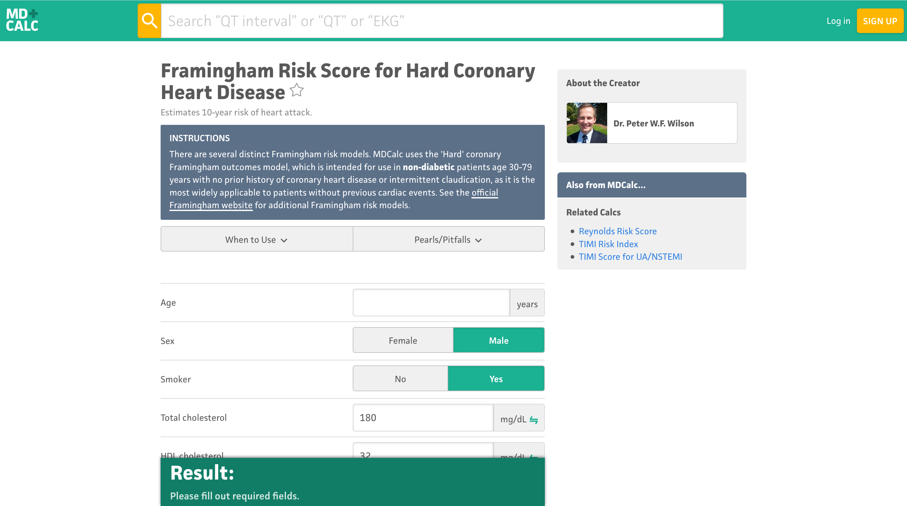

Slide 6
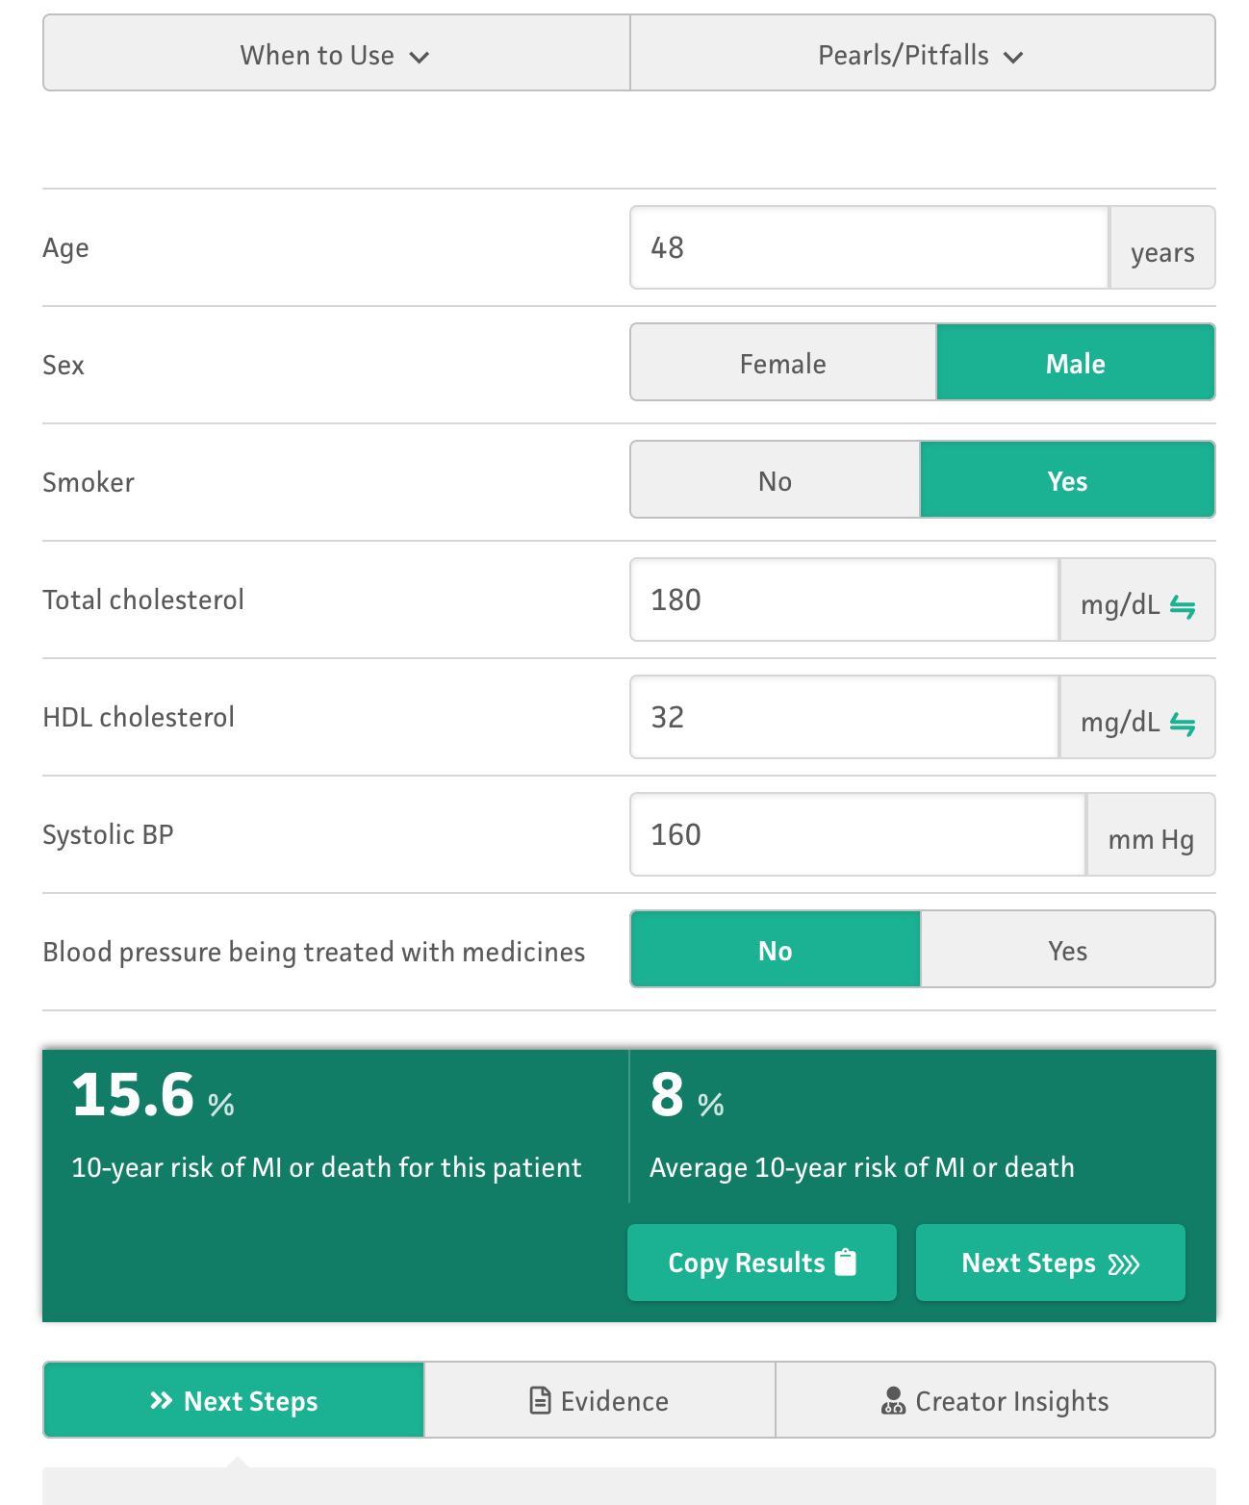

Slide 7
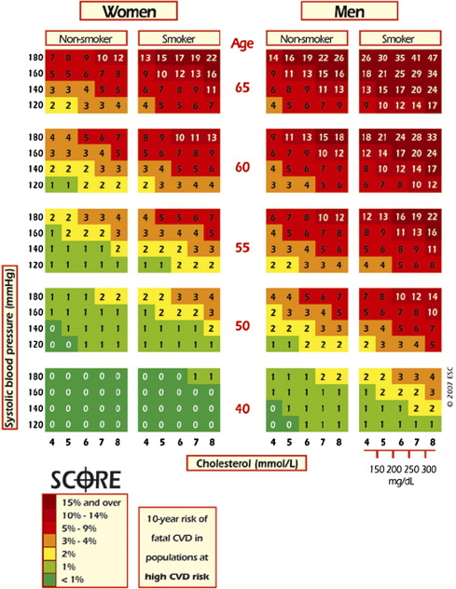

Slide 9
STATITICAL ANALYSES
Sex-specific Cox proportional-hazards regressions
10-year absolute CVD risk
All continuous variables where natural Log transformed.
Added Interaction antiHT medication and SBP
IV- ASSESMENT OF MODEL PERFORMANCE
Overall c-statistic.
Bootstrap resampling of the original set
Kaplan-Meier estimator to obtain OBSERVED INCIDENCE.
Modified HOSMER-LEMESHOW X2 to compare observed and predicted, classified in deciles.

Slide 10

Sensitivity of the top sex-specific quintile of predicted risk
Agostino Wilson
Men 49% 47%
Women 60% 56%
Specificity
Men 85% 85%
Women 84% 83%

Slide 11
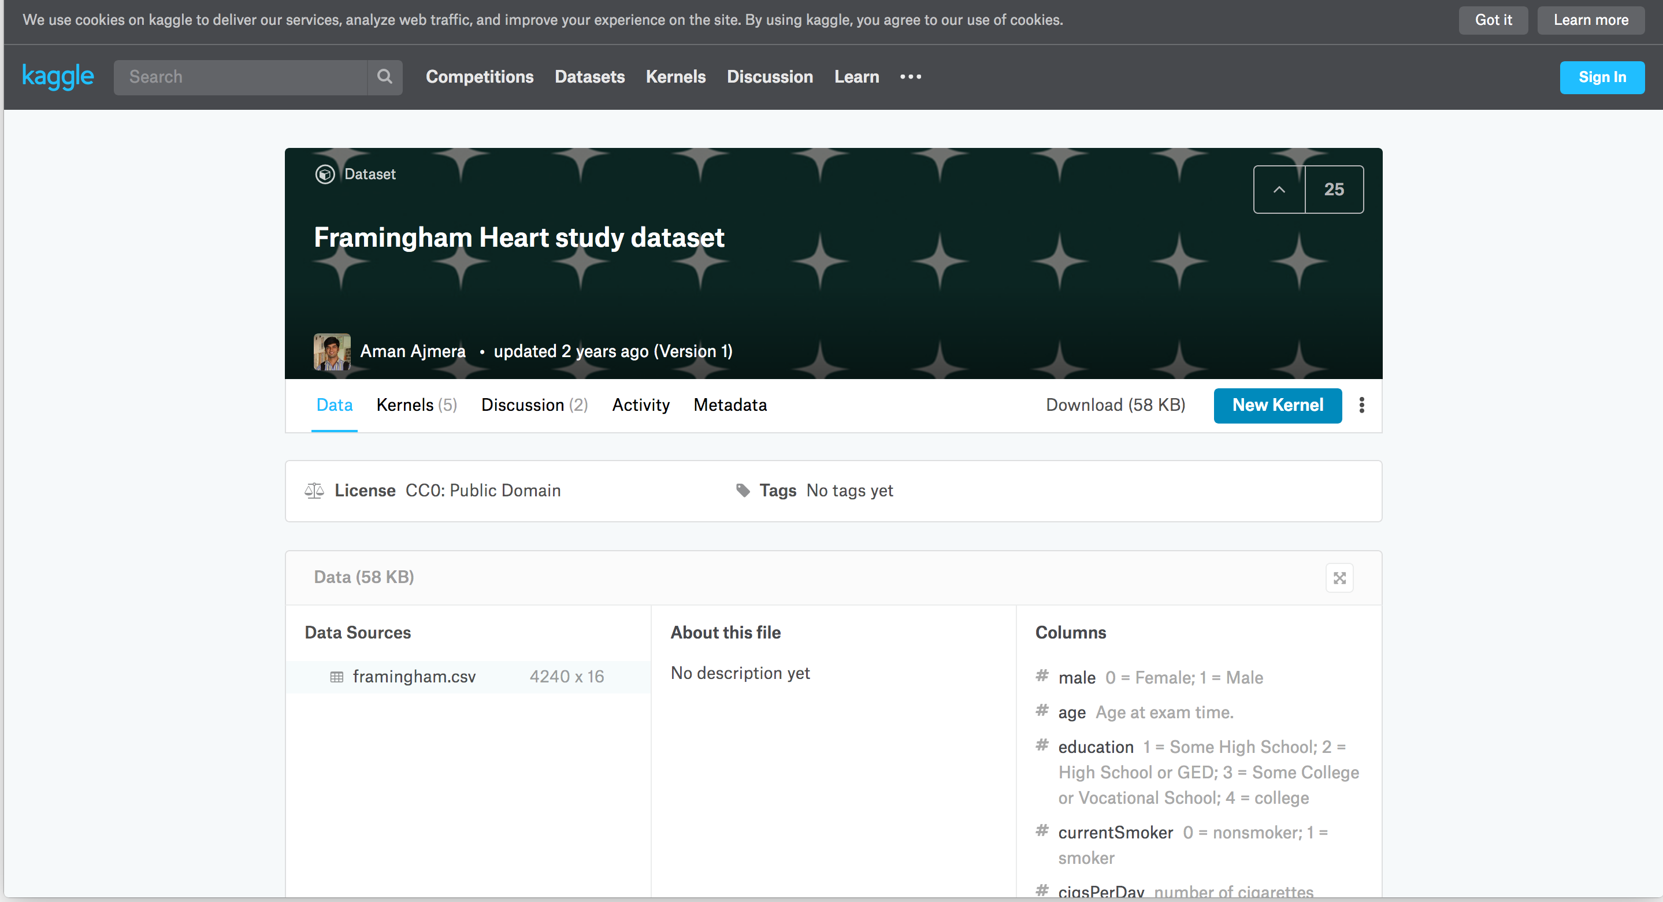



Slide 12
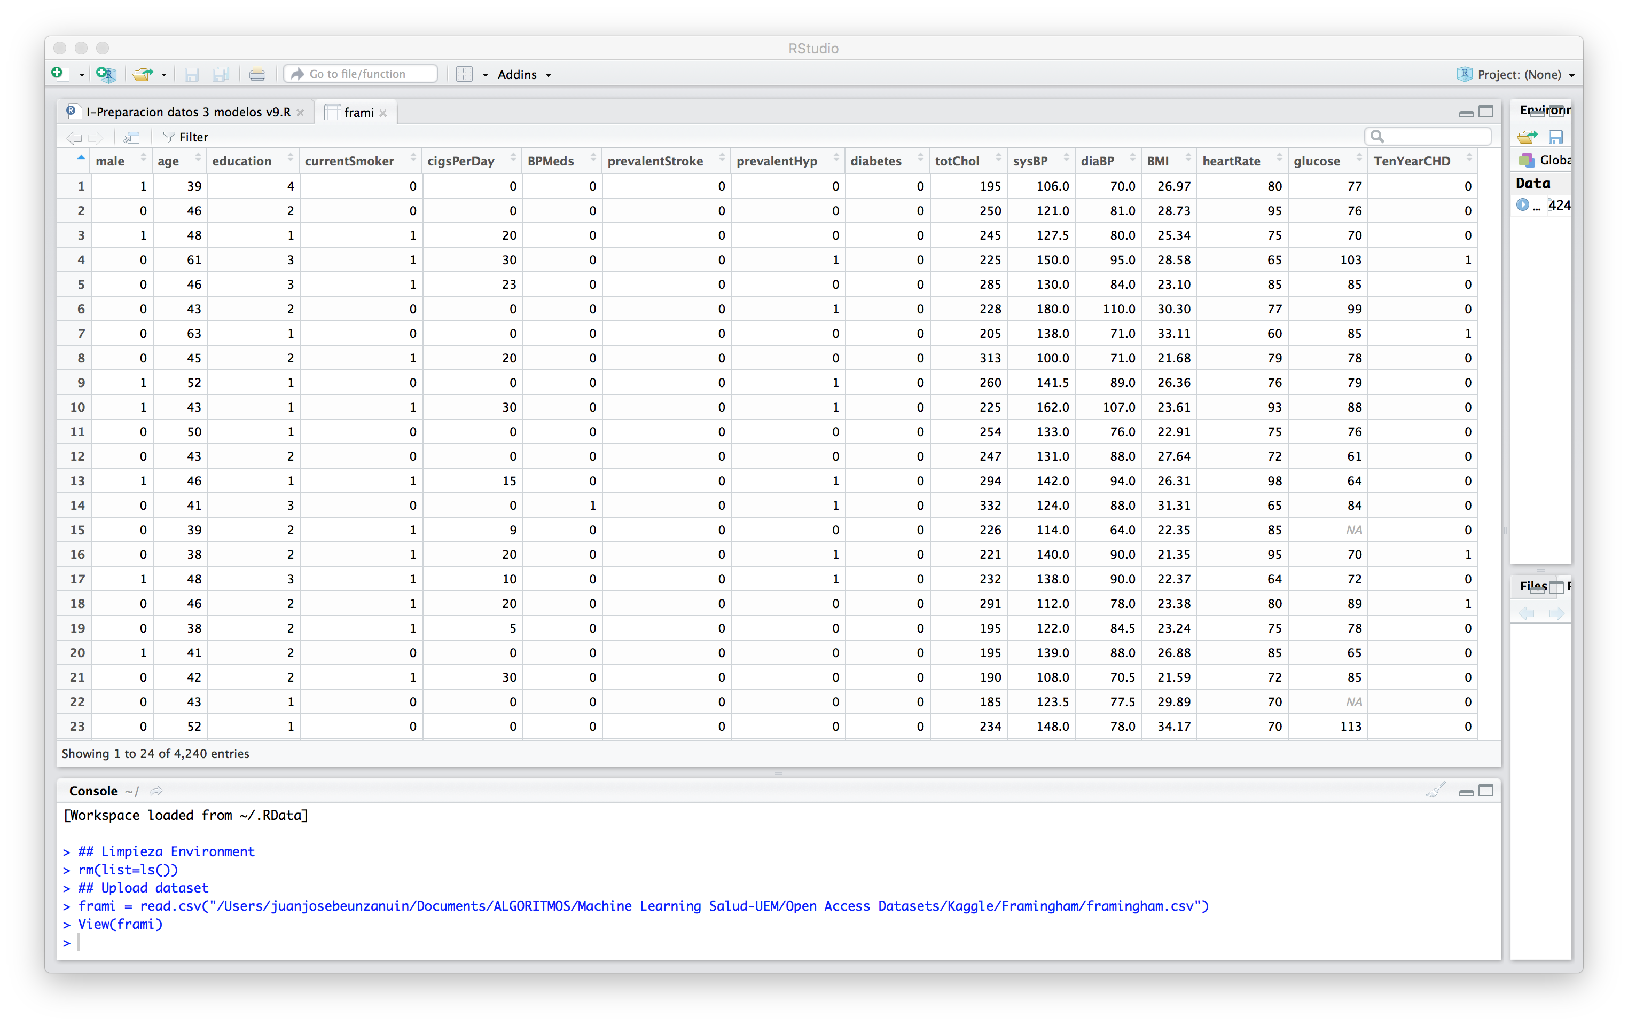

Slide 13
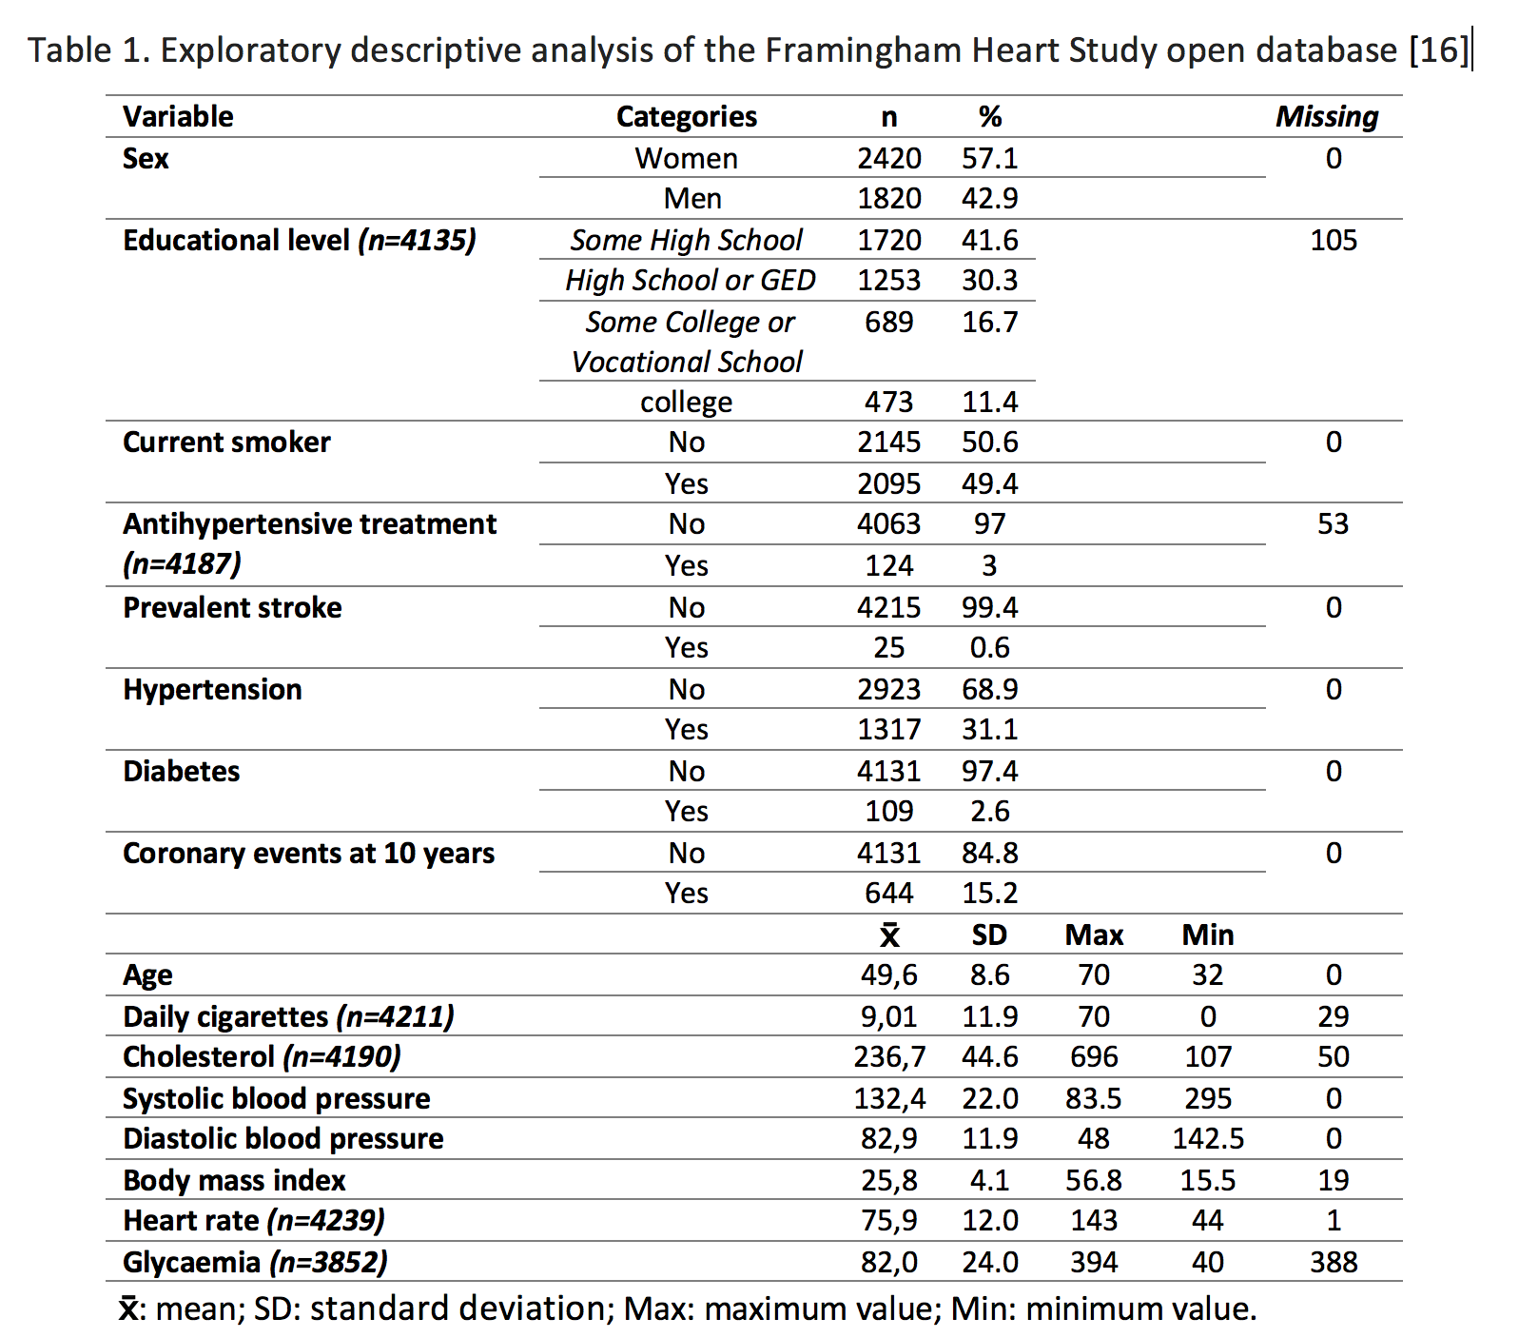

Slide 14
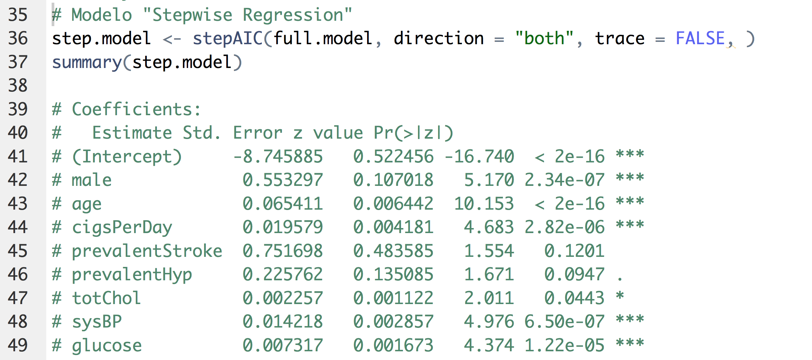
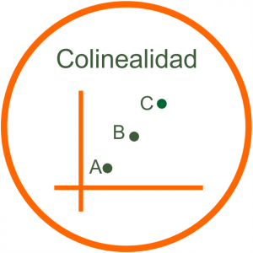

Slide 15


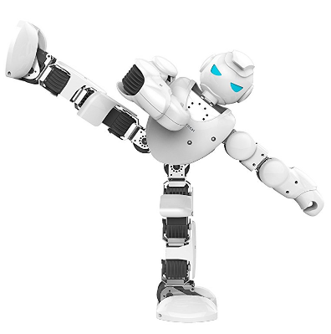

MODELO A
Raw

Slide 16

MODELO A
Raw
ACC
85

Slide 17


MODELO A
Raw
ACC SEN
85 6

Slide 18
REAL
PREDICHO
🤓 🤓 🤓 🤓 🤓 🤓 🤓 🤓 🤓 🤓
🤓 🤓 🤓 🤓 🤓 🤓 🤓 🤓 🤓 🤓
🤓 🤓 🤓 🤓 🤓 🤓 🤓 🤓 🤓 🤓
🤓 🤓 🤓 🤓 🤓 🤓 🤓 🤓 🤓 🤓
🤓 🤓 🤓 🤓 🤓 🤓 🤓 🤓 🤓 🤓
🤓 🤓 🤓 🤓 🤓 🤓 🤓 🤓 🤓 🤓
🤓 🤓 🤓 🤓 🤓 🤓 🤓 🤓 🤓 🤓
🤓 🤓 🤓 🤓 🤓 🤓 🤓 🤓 🤓 🤓
🤓 🤓 🤓 🤓 🤓 😎 😎 😎 😎 😎
😎 😎 😎 😎 😎 😎 😎 😎 😎 😎
🤓 🤓 🤓 🤓 🤓 🤓 🤓 🤓 🤓 🤓
🤓 🤓 🤓 🤓 🤓 🤓 🤓 🤓 🤓 🤓
🤓 🤓 🤓 🤓 🤓 🤓 🤓 🤓 🤓 🤓
🤓 🤓 🤓 🤓 🤓 🤓 🤓 🤓 🤓 🤓
🤓 🤓 🤓 🤓 🤓 🤓 🤓 🤓 🤓 🤓
🤓 🤓 🤓 🤓 🤓 🤓 🤓 🤓 🤓 🤓
🤓 🤓 🤓 🤓 🤓 🤓 🤓 🤓 🤓 🤓
🤓 🤓 🤓 🤓 🤓 🤓 🤓 🤓 🤓 🤓
🤓 🤓 🤓 🤓 🤓 🤓 🤓 🤓 🤓 🤓
🤓 🤓 🤓 🤓 🤓 🤓 🤓 🤓 🤓 🤓
15% Incidencia
85% Accuracy

Slide 19
MODELO A
Raw
ACC SEN
85 6
Missing

Slide 20
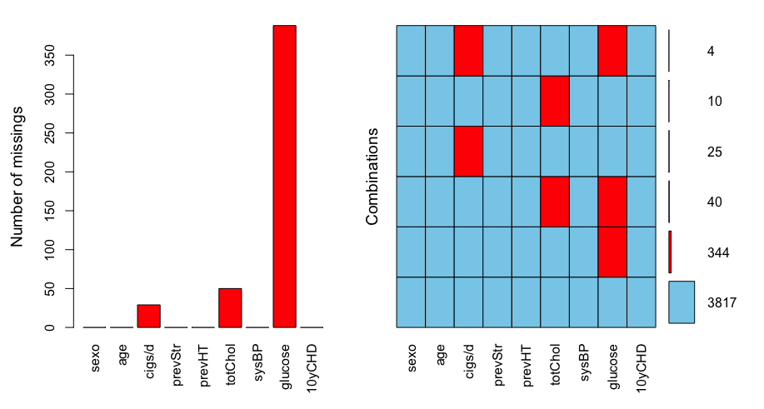

Slide 21
MODELO A
Raw
ACC SEN
85 6
Missing
/= Rango

Slide 22
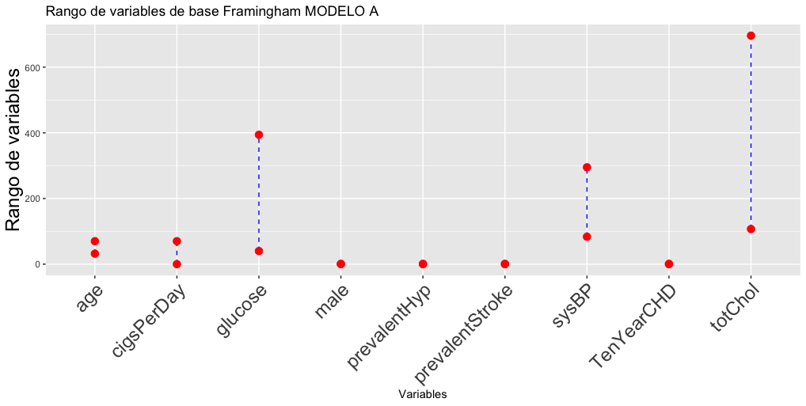

Slide 23
MODELO A
Raw
ACC SEN
85 6
Missing
/= Rango
Balanceo

Slide 24
MODELO A MODELO B MODELO C
Raw Complete Case Analysis Imputación
Normalizado/Estandarizado Normalizado/Estandarizado
Balanceado Balanceado
ACC SEN
85 6
Missing
/= Rango
Balanceo

Slide 25
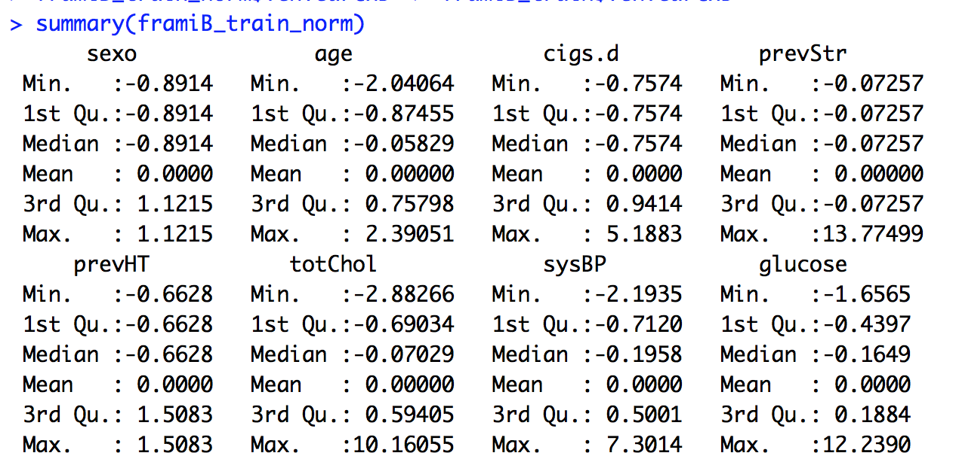
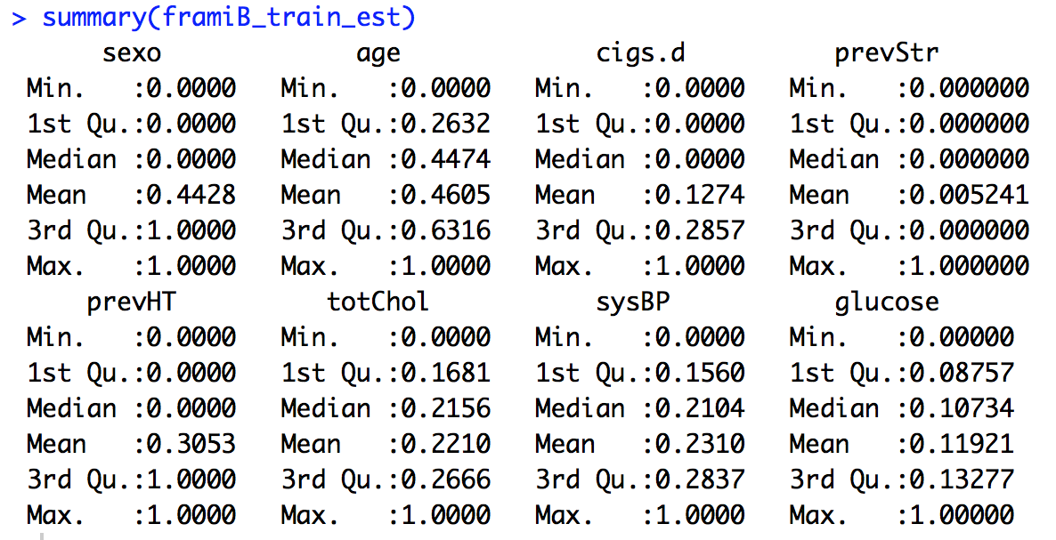
# Normalization (media = 0; rango variable). Better for normal distribution.
normalizar <- function(x) {
return((x - mean(x)) / sd(x))
}
# Estandarización o Max-min Normalization (rango de 0 a 1; media =/ 0,5). Better for non-normal distribution.
estandarizar <- function(x) {
return((x - min(x)) / (max(x)-min(x)))
}

Slide 26

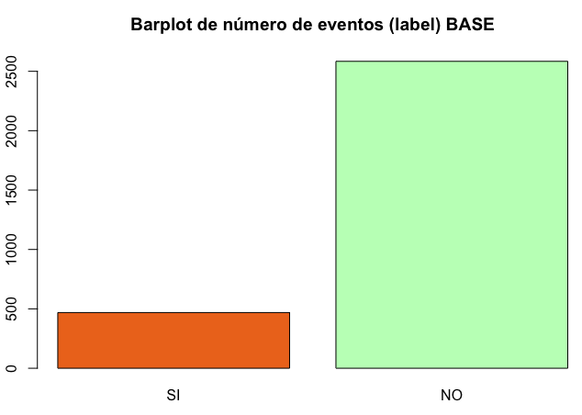
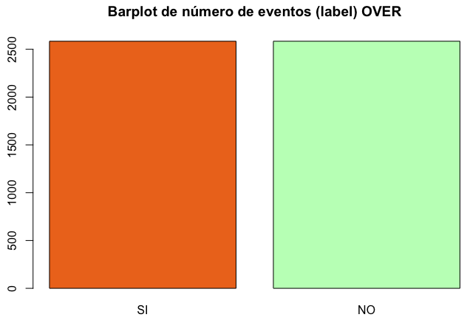
1. OVER
50%
15%

Slide 27
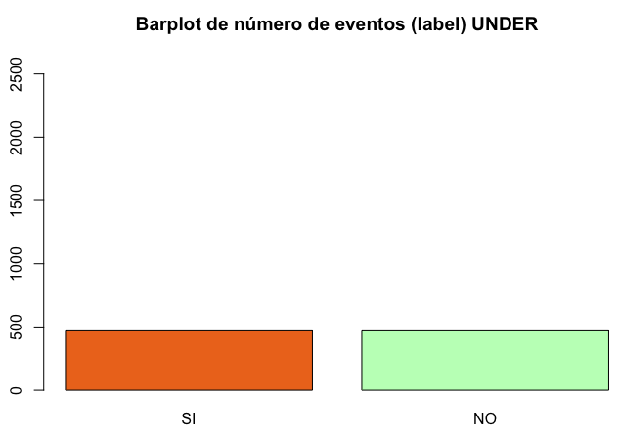
2. UNDER
15%
50%

Slide 28
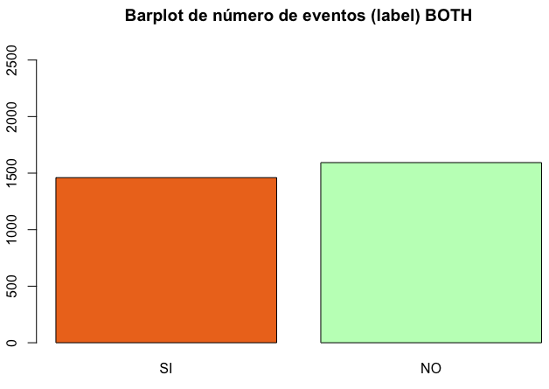
3. BOTH
50%
15%

Slide 29

4. ROSE
50%
15%

Slide 30
library(ROSE)
# Balanceo sobre base normalizada
# I- Oversampling
framiB_train_norm_bal_over <- ovun.sample(TenYearCHD~., data = framiB_train_norm, method = "over", N=5168)$data
# II- Undersampling
framiB_train_norm_bal_under <- ovun.sample(TenYearCHD~., data = framiB_train_norm, method = "under", N = 938, seed = 1)$data
# III- Both over and under sampling
framiB_train_norm_bal_both <- ovun.sample(TenYearCHD ~ ., data = framiB_train_norm, method = "both", p=0.5, N=3053, seed=1)$data
# IV- ROSE: Mixed method with over and under sampling
framiB_train_norm_bal_rose <- ROSE(TenYearCHD ~ ., data = framiB_train_norm, seed = 1)$data

Slide 31
MODELO A MODELO B MODELO C
Raw Complete Case Analysis Imputación
Normalizado/Estandarizado Normalizado/Estandarizado
Balanceado Balanceado
ACC SEN ACC SENS ESP VPP VPN AUC ACC SENS ESP VPP VPN AUC
85 6 81 28 91 37 87 0,60 84 5 99 44 85 0,52
79 35 88 39 86 0,63 78 30 87 31 87 0,59
69 67 69 29 92 0,68 68 69 68 28 92 0,68
67 70 66 28 92 0,71 71 64 72 29 92 0,68

Slide 32
Sensitivity
Agostino Wilson
Men 49% 47%
Women 60% 56%
Specificity
Men 85% 85%
Women 84% 83%
MODELO A MODELO B MODELO C
Raw Complete Case Analysis Imputación
Normalizado/Estandarizado Normalizado/Estandarizado
Balanceado Balanceado
ACC SEN ACC SENS ESP VPP VPN AUC ACC SENS ESP VPP VPN AUC
85 6 81 28 91 37 87 0,60 84 5 99 44 85 0,52
79 35 88 39 86 0,63 78 30 87 31 87 0,59
69 67 69 29 92 0,68 68 69 68 28 92 0,68
67 70 66 28 92 0,71 71 64 72 29 92 0,68

Slide 33
# Training decision tree
library(C50)
framiB_model <- C5.0(framiB_train[-9], framiB_train$TenYearCHD)
# Improving model performance
framiB_boost10 <- C5.0(framiB_train[-9], framiB_train$TenYearCHD, trials = 10)
# Training random forest
library(randomForest)
set.seed(300)
rfB1 <- randomForest(TenYearCHD ~ ., data = framiB_train, importance=TRUE)
rfB1
# Training svm
library(kernlab)
# Normalizado
framiB_norm_bal_over_classifier <- ksvm(TenYearCHD ~ ., data = framiB_train_norm_bal_over, kernel = "vanilladot")
# Training neural network
library(neuralnet)
framiB_norm_bal_over_model_9_9 <- neuralnet(TenYearCHD ~ male + age + cigsPerDay + prevalentStroke + prevalentHyp + totChol + sysBP + glucose, data = framiB_train_norm_bal_over, hidden = c(9,9), threshold = 0.1)

Slide 34



¿Por qué esos valores tan bajos?
Bajo tamaño muestral n=4240
Pequeño número de variables var=16
Variables poco predictoras
Faltan variables relevantes LDL-cholesterol…?
¿Mal ajuste hiperparámetros? Premios
Multiples análisis sensibilidad
70 arquitecturas en RN

Slide 35
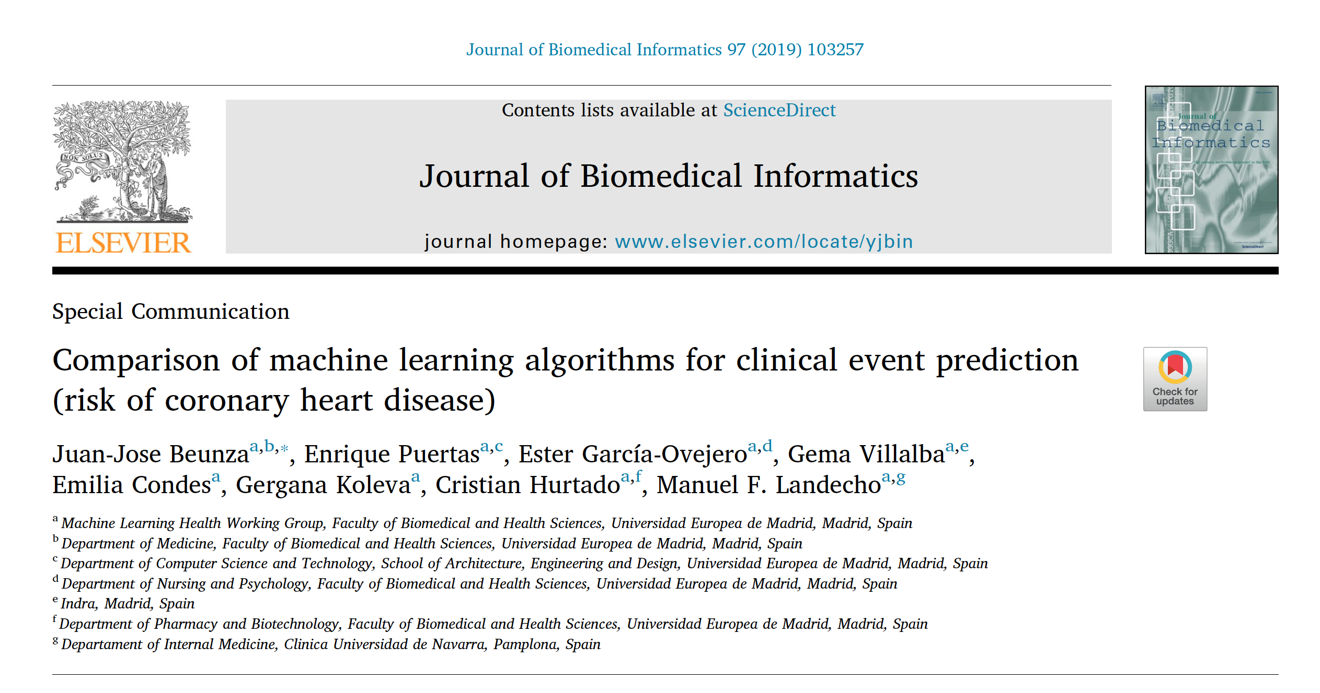

Slide 36
rapidminer.com

Slide 37
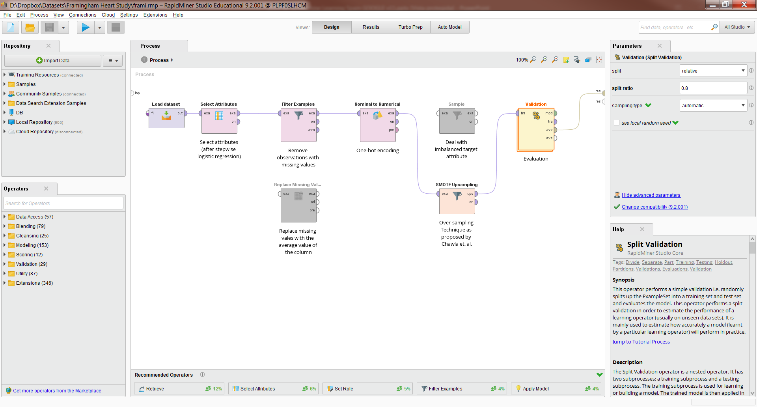

Slide 38
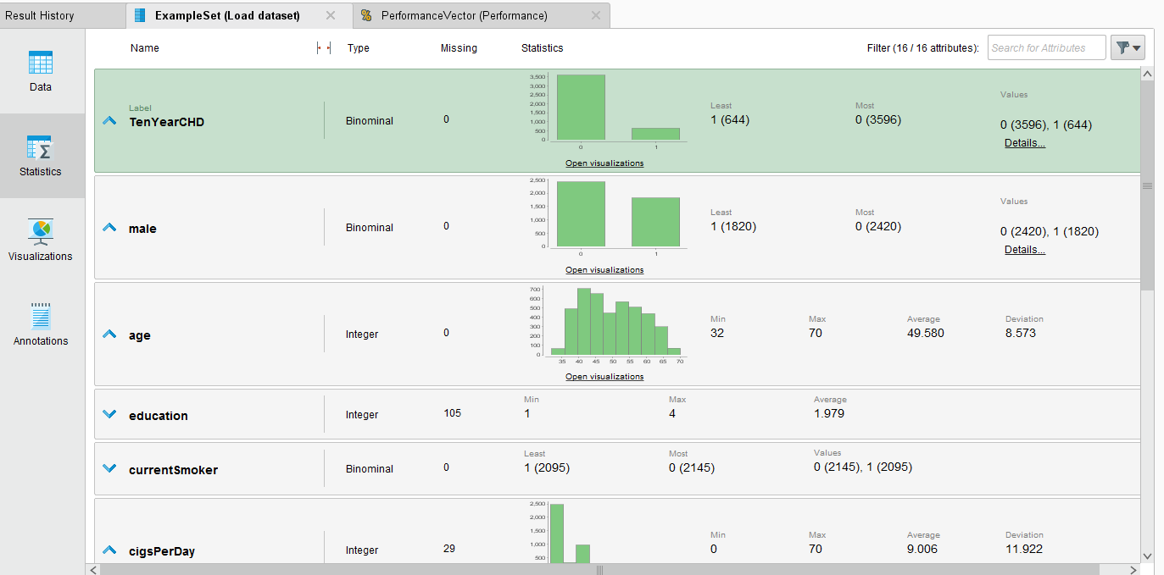

Slide 39
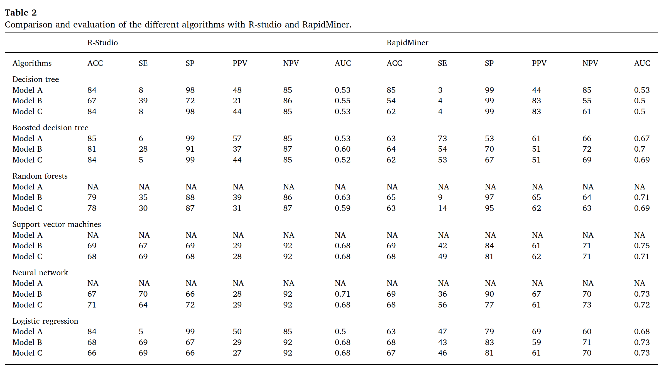

Slide 40
CONCLUSIONES
Posibilidades inmensas ML salud
R y RapidMiner son válidas
Equipos híbridos (técnicos IT y sanitarios)*
Normalización y estandarización resultados ~=
Balanceo under y over
SVM y RN – Datos tabulados

Slide 41

01100111 01110010 01100001 01100011 01101001 01100001 01110011!!!
juanjo@juanjobeunza.com

